Slide 1

INNOVATE AT SCALE WITH CONFIDENCE POWERING A SECURE AND RESILIENT AI ESTATE
Colm Moynihan
Principal Solution Engineer
Notes:
Welcome everyone. I'm Colm Moynihan and I lead Trust Center engineering at Snowflake.
Today I want to talk about something that's top of mind for every security leader I speak with: how do you innovate at scale with AI — build agents, deploy models, unlock new use cases — without losing control of your security posture?
That tension between speed and safety is real. And it's exactly what we've been building for.
[~30 seconds]

Slide 2
Top Concerns From Security Leaders
Identity and
Access Control
Data Exfiltration and Unauthorized Data Movement
Centralized Visibility
Least privileged access
Access to sensitive data
Single pane of glass
Notes:
We've had conversations with CISOs and security architects throughout the past year, and three themes come up consistently.
First: least-privileged access and agent identity. Who is this agent? What can it do? In a world where autonomous agents are making API calls and querying data, the old "just give it admin" approach doesn't work.
Second: data exfiltration and unauthorized data movement. Agents can read data and send it anywhere. Without the right controls, you have a real risk of agents leaking sensitive information — whether through prompt injection, misconfiguration, or simple over-permissioning.
Third: centralized visibility. Security teams tell us they're flying blind. They don't have a single place to understand what AI workloads are running, what data they're touching, and whether their security controls are keeping pace.
These aren't hypothetical risks. They're the daily reality for teams deploying AI in production. And this week's launches directly address all three.
[~2 minutes]

Slide 3
Security Investments at a Glance
Proactive enterprise-grade security capabilities for data and AI—built-in, not bolted on
SNOWFLAKE
Cortex AI
Coding Agent
CoCo
Orchestration
Cortex Agent
Business Agent
Snowflake CoWork
Analytics & Predictive Insights
AI Functions & Snowflake ML
Connection
Snowflake Managed MCP Server
Agent Security
Data Security
Platform Security
Prompt Protection
Horizon AI Guardrails
Data Integrity and Encryption
Sensitive Data Protection
Authentication
SSO / Provisioning
Agent Identification
Agent Identity
Data Egress
Data Exfiltration Protection
Authorization
RBAC / ABAC
AI Posture
AI Security Package
Data-Leak Prevention
Ransomware Protection
Secure Boundary
Network Security
Trust Center – Security Posture
Horizon Catalog
Notes:
At Snowflake, our philosophy is simple: proactive, enterprise-grade security for data and AI — built in, not bolted on.
Let me walk you through the layers.
At the foundation is platform security — authentication, SSO, RBAC, network policies. This has been Snowflake's strength for years and we continue to invest here.
On top of that is data security — Horizon Catalog for sensitive data protection, encryption, data integrity. This week we're expanding this layer with data exfiltration protection and ransomware protection through data egress controls and data-leak prevention.
And now the newest layer: agent security. Purpose-built controls for the agentic era. Agent Identity gives every agent a verifiable identity. Horizon AI Guardrails protect against prompt injection and unsafe outputs. And AI Security Posture Management in Trust Center continuously monitors your AI workloads.
Every layer builds on the one below it. You don't bolt agent security onto a platform with weak fundamentals — you build it on top of strong platform and data security. That's the approach.
[~2 minutes]

Slide 4
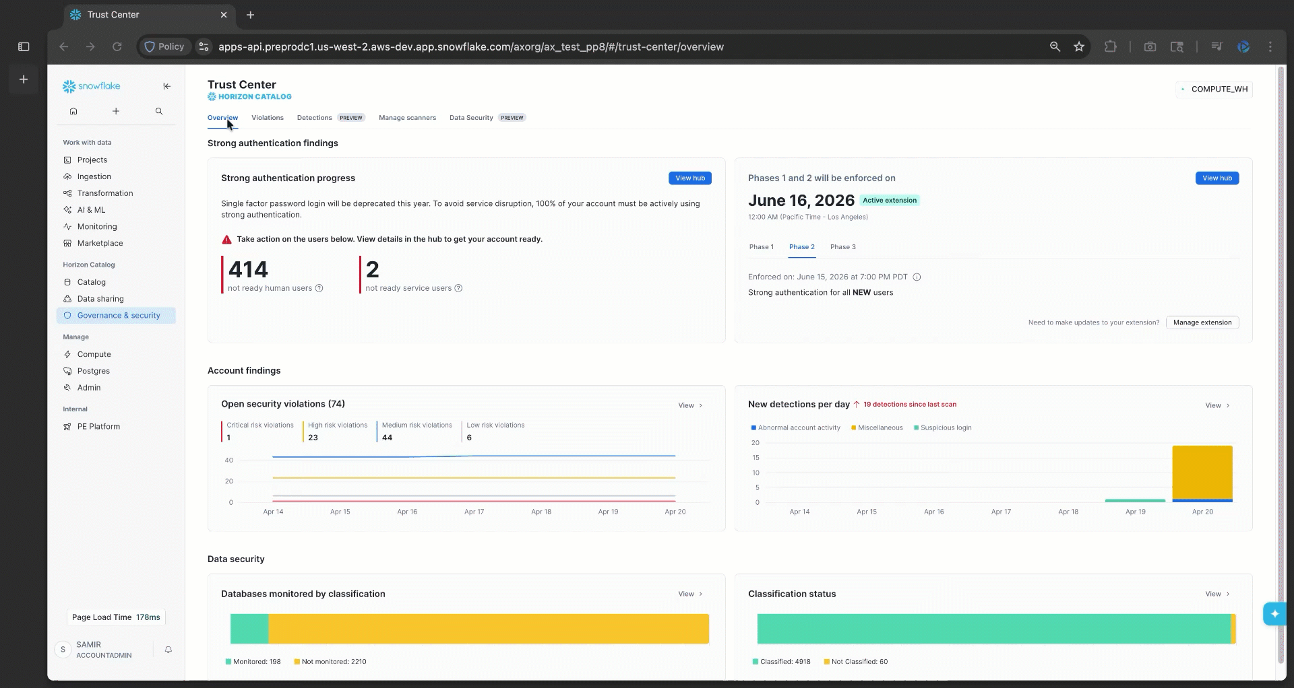
Trust Center
In Dev
Private
Public
GA
WHAT IS IT
Discover & remediate security, identity, data governance, and compliance risks
Streamline cross-cloud security monitoring in one centralized place Lower TCO and reduce account risks
Scan accounts to detect security violations based on Snowflake CIS Benchmark
WHY USE IT
HOW TO USE IT
Notes:
Trust Center is Snowflake's single pane of glass for security, compliance, and governance — across accounts, across clouds.
What is it? It scans your accounts against the Snowflake CIS Benchmark and other security frameworks, surfaces findings, and tells you exactly how to remediate them.
Why use it? Because managing security across a modern data and AI estate manually doesn't scale. You need automated, continuous monitoring that catches misconfigurations before they become incidents.
When we launched Trust Center, it was about surfacing violations and manual remediation. Today, we've evolved significantly: from violations to near real-time detections, from manual remediation to AI-assisted remediation, and from SSPM and DSPM to AI Security Posture Management.
I'll show you all of this in the demo. But first, let me highlight two major new capabilities.
[~1.5 minutes]

Slide 5

AI Security Posture Management
In Dev
Private
Public
GA
Secure by Design & Secure by Default
Built-in native AI SPM Capabilities across 5 pillars Enforce guardrails, discover, and remediate vulnerabilities
Works within your Snowflake account boundary Monitor Cortex AI Monitor 1P, 2P, and 3P* Agents
Enable via Trust Center Use via UI, CoCo CLI, Programmatically, or Org Wide
WHAT IS IT
Observability
Supply Chain
WHY USE IT
AI security
HOW TO USE IT
Runtime Auditing
Runtime Protection
Notes:
AI Security Posture Management is one of the most significant capabilities we're launching this week.
Trust Center now monitors not just your platform and data — but your AI workloads and agents. It provides built-in, native AI SPM across five pillars: AI Security, Runtime Protection, Runtime Auditing, Observability, and Supply Chain monitoring.
A critical benefit: these scanners run entirely within your Snowflake account boundary. No data leaves your trusted perimeter. That matters when you're scanning for sensitive data accessed by agents or checking whether guardrails are properly configured.
It works across first-party Cortex AI, second-party partner models, and third-party agents running in your account. You enable it through Trust Center and can interact with it through the UI, CoCo CLI, or programmatically.
I'll enable this live in the demo and show you exactly what it detects.
[~1.5 minutes]

Slide 6
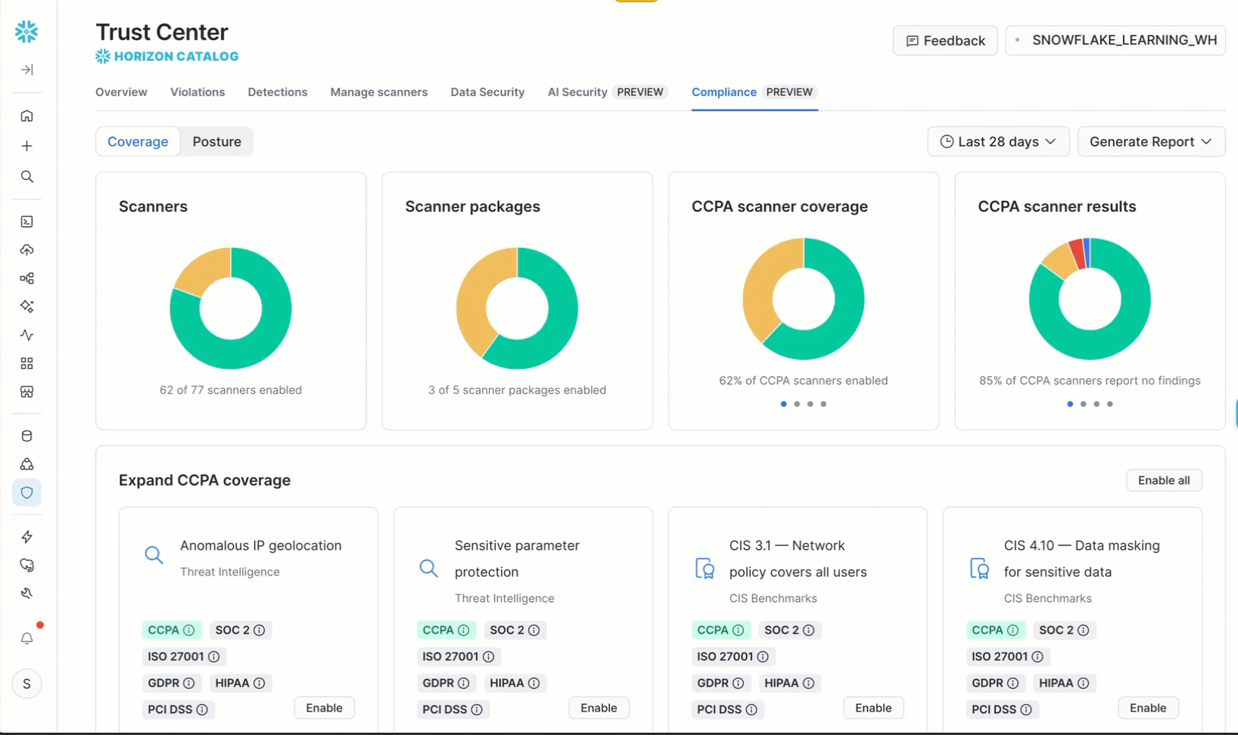
Trust Center: Reports for Audit and Compliance
In Dev
Private
Public
GA
WHAT IS IT
Generate reports for audit and compliance use case Enriched with account specific information
No manual collection of data Get account specific reports with 1-click actions
Use CoCo to generate the reports you need Use Snowsight to download reports in PDF
WHY USE IT
HOW TO USE IT
Notes:
The last capability I want to highlight before the demo is compliance reporting.
Before this, generating a security report for an audit meant manually pulling data from multiple sources, stitching it together, formatting it. Hours of work every time an auditor came knocking.
Now: one click. Trust Center generates reports aligned with compliance standards like SOC and PCI, automatically enriched with your account-specific data. No manual data collection. You can further customize these reports using CoCo, and download them as PDFs directly from Snowsight.
This closes the loop from detection to remediation to evidence. You find the issue, you fix it, and you prove you fixed it — all from one place.
Now let me show you all of this in action.
[~1 minute]

Slide 7
DEMO
Notes:
[DEMO — ~8 minutes. See demo_walkthrough.md for detailed UI navigation steps and demo_trust_center.sql for the SQL script.]
ACT 1 — The Single Pane of Glass (~2 min):
Open Trust Center in Snowsight. Show the dashboard — severity badges, scanner packages. Point out CIS Benchmarks and Security Essentials are active; AI Security and Threat Intelligence are not yet enabled. Run scanner coverage query to show 100% coverage. Drill into CIS 3.1 (no network policy — Critical) and CIS 1.14/1.15 (tasks with admin privileges — High). Show that Trust Center provides the exact remediation SQL.
ACT 2 — PII Classification and Data Protection (~2 min):
Show the HR_DATA table. Run EXTRACT_SEMANTIC_CATEGORIES to auto-classify columns. Apply tags with ASSOCIATE_SEMANTIC_CATEGORY_TAGS. Show masking in action on STOCK_ANALYST_DATA — full visibility as admin, redacted as restricted role. Connect back to Trust Center via CIS 4.10 (unmasked sensitive data). Show the Data Security tab dashboard.
ACT 3 — Agent Security, Enable Live (~2 min):
Show AI Security package is disabled. Enable it with one command. Show the four AI security scanners — guardrails, sensitive data access by agents, privileged search services, PAT scope. Run the scanners and show findings.
ACT 4 — Threat Detection (~2 min):
Enable Threat Intelligence. Walk through the 18 detection scanners across four categories: Identity & Auth, Privilege Monitoring, Anomaly Detection, Data & Config Protection. Run scanners and show the full security posture summary — all four packages enabled, full coverage, all findings in one place.
CLOSING LINE: "Four packages. All enabled. Full coverage. Every at-risk entity visible in one place. This is proactive, enterprise-grade security for data and AI — built in, not bolted on. Thank you."
[Total presentation: ~15 minutes — 7 minutes slides + 8 minutes demo]

